Slide 1
Chapter 4
Anatomy of MapReduce

Slide 2
Big Data Application: Social Media Influencers
Social media giants
Use influencers in their networks to boost collaborations between brands and influencers
Include Twitter, Facebook, Instagram, and LinkedIn
This marketing approach => influencer marketing
Identifying the influencers among the large number of network members:
Requires processing a massive amount of data
MapReduce is the weapon of choice
Researchers form Hiroshima University:
Developed an efficient and scalable algorithm that uses a MapReduce framework
Analyzes:
The number of friends that a person has in a social network, the number of followers, the average number of "likes," the positive and negative comment replies

Slide 3
Introduction
Two components of Hadoop:
Distributed file system (storage component):
Distributes input data and files across nodes
Creates redundancy
Improves data and system reliability
Tracks the location of data among data nodes
MapReduce (processing component):
Uses JobTracker and TaskTrackers
Generates tasks from the main algorithms and distributes those tasks across nodes

Slide 4
Introduction (cont.)
Traditional paradigms:
Transfer the data to one location
Big data:
The algorithm (not the data) travels through the network to the DataNodes to perform the data processing tasks
This process is called mapping
A second stage, reducing, is performed to complete the algorithm
The results from the mapping generated in each DataNode:
Aggregated via the reducing stage

Slide 5
Chapter Objectives:
Understand the concepts behind the MapReduce paradigm
Describe the components of MapReduce, such as the mapper, combiner, and reducer
Explore various MapReduce patterns and examples
Execute MapReduce jobs in a Hadoop cluster using either Java or Python
Explore several data processing problems that can utilize MapReduce algorithms
Modify existing MapReduce algorithms to perform new data processing problems

Slide 6
The MapReduce Concept
Enable massive scalability when processing large amounts of data and records
Allow millions or billions of records to be spread across commodity servers in a Hadoop cluster
Main idea, like in Roman times:
Each census taker in each city would be tasked to count the number of people in that city and then return their results to the capital city
The results from each city would be reduced to a single count (sum of all cities) to determine the overall population of the empire

Slide 7
The Main Components of MapReduce
Two stages:
Mapper
Reducer

Slide 8
Mapper
Reads and processes a set of data
Converts it into another set of data
Both input and output data consist of a set of rows or records:
Tuples:
Key
Value
Once the map jobs are completed in all data nodes:
Second stage => the reducer starts

Slide 9
Reducer
After the mapper has completed its job in all data nodes
Takes the map output as input
Aggregates or combines it into the final results

Slide 10
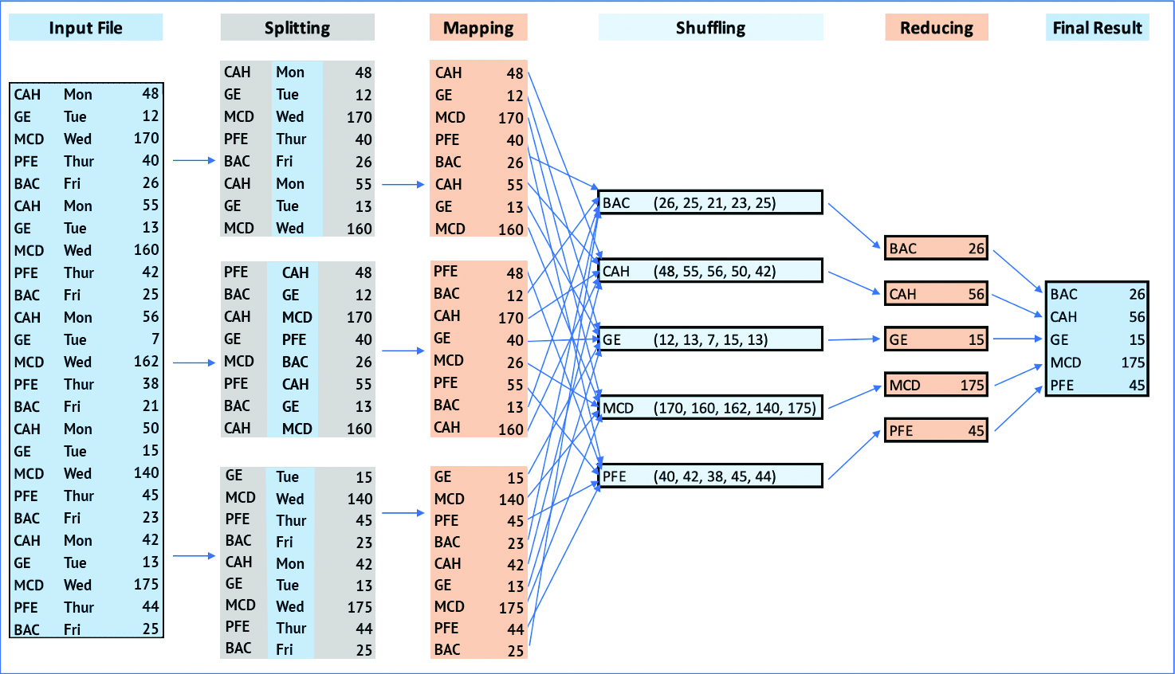
Figure 4 -1: Logical Model for the MapReduce Algorithm

Slide 11
MapReduce Illustration
Reads the input file in (key, value) format
Key:
Byte offset
Integer used to find the absolute address
Byte offset of first line: 0
Value:
The entire line of the input file that starts at the byte offset
First tuple in input file: (0, 'CAH Mon 48')

Slide 12
MapReduce Illustration: Mapper
Input file:
Split into separate blocks
Data blocks wait in their respective DataNode for the map job to arrive
Mapper:
Takes the (key, value) pairs
Generates a new set of (key, value) pairs
For all DataNodes
New key => the value of the ticker in the line
The value => the stock price
(0, 'CAH Mon 48') transferred to ('CAH', 48)

Slide 13
MapReduce Illustration: Shuffling
Before reducer stage
Hidden from the programmer
Groups the records emitted in the mapper
Sends items with the same key to the same reducer

Slide 14
MapReduce Illustration: Reducer
Combines the input tuples
Outputs the maximum value for each stock
Producing a final result set:
('BAC', 26) ('CAH', 56) ('GE', 15) ('MCD', 175) ('PFE', 45)
Automatically sorts the results in ascending order based on the output key
Sorting:
Hidden from the programmer
Hadoop uses a very efficient sorting algorithm known as TeraSort

Slide 15
The Pseudocode of MapReduce
Implemented with:
Java
Python
Any other programming language

Slide 16
The Pseudocode of MapReduce: Mapper
Executes each line of input file until no more lines remain
Creates tokens by splitting each line value into its components:
Emits the necessary components for further processing
function map (K1, V1)
{
tokens = split(V1) // tokens = ['CAH', 'Mon', '48']
ticker = tokens [0]
trade_price = token [2]
emit (ticker, trade_price) // emits ('CAH', 48)
}
Box 4-1: Pseudocode for the Mapper

Slide 17
The Pseudocode of MapReduce: Reducer
After the shuffling process
Receives the mapper's output in the form of a series of (key, value) pairs
Processes all the key-value pairs generated by the mapper
For each key:
Reducer reads the values from the list (V2), until no values remain
Starting with the MaxPrice of 0, the reducer compares each trade_price from the list and updates the maximum price if the selected value is higher than MaxPrice
function reduce (K2, V2)
{
MaxPrice = 0;
for (i=0; i < V2.length; i++){
if (V2[i] > MaxPrice) then MaxPrice = V2[i]
}
emit (K2, MaxPrice) // emits ('CAH', 56)
}
Box 4-2: Pseudocode for the Reducer

Slide 18
The Pseudocode of MapReduce: Combiner
Speeds up the MapReduce algorithm
"Local reducer"
Reduce function applied on the split file to generate intermediate aggregated results
Optional
AKA a semi-reducer, as it:
Accepts the inputs from the mapper
Passes the output (key, value) pairs to the reducer
Used in between the mapper and the reducer
To reduce the volume of data transfer between these two stages

Slide 19
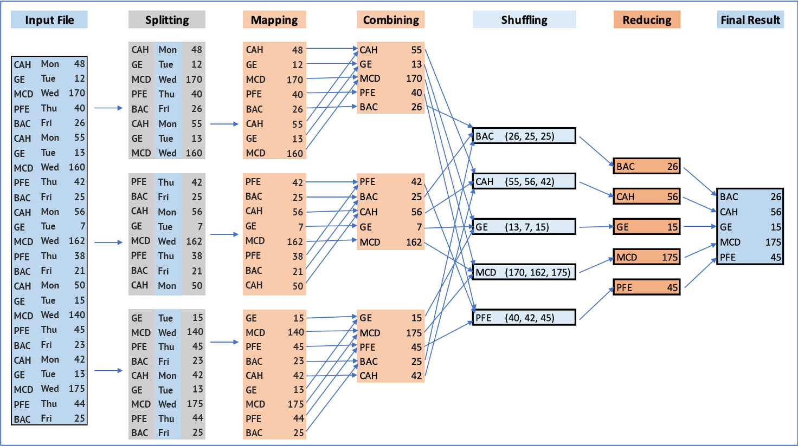
Figure 4-2: Logical Model for the MapReduce Algorithm with a Combiner

Slide 20
Why Is Combiner Important?
Minimizes the data transfer over the network
Loosens the workload on the reducer
Primary function:
Summarizes the map output records with the same key
Only used to process associative operations:
Calculation gives the same result regardless of the way the input components are grouped
Example: addition and multiplication

Slide 21
function reduce (K2, V2)
{
MinPrice = V2[0];
for (i=1; i < V2.length; i++){
if (V2[i] < MinPrice) then MinPrice = V2[i]
}
emit (K2, MinPrice)
}
Box 4-3: Adjusting the Reducer to Emit the Minimum Price

Slide 22
function reduce (K2, V2)
{
SumPrice = 0;
for (i=0; i < V2.length; i++){
SumPrice = SumPrice+ V2[i]
AvgPrice = SumPrice/(V2.length+1) //divide by the number of days
}
emit (K2, AvgPrice)
}
Box 4-4: Adjusting the Reducer to Emit the Average Price

Slide 23
Driver
Initializes the program
Sets the input file
Instructs the Hadoop platform to execute the mapper, combiner (if present), and reducer
Controls where the output files are placed in the Hadoop cluster

Slide 24
MapReduce Patterns and Examples
Text Mining with MapReduce:
Variation of data mining techniques
Patterns are extracted from a collection of text documents
Input files consist of unstructured and voluminous pages from:
Websites
Business documents
Research articles
Government reports

Slide 25
WordCount Algorithm
Counts the number of occurrences of each word in a given input file
Input file is split into several DataNodes
Mapper in the WordCount:
Reads each word in the input file
Emits that word and the number 1 as the (key, value) pair: (word,1)
Shuffling stage:
Sorts and groups these words
Sends the new (key, value) pairs with the same key (same word) to the same reducer
Example: Record [customers, (1, 1, 1)]
Shows that the word customers is present three times
This word is present once in each of the three DataNodes
The reducer adds the ones and emits the word and the sum as the frequency of the word

Slide 26
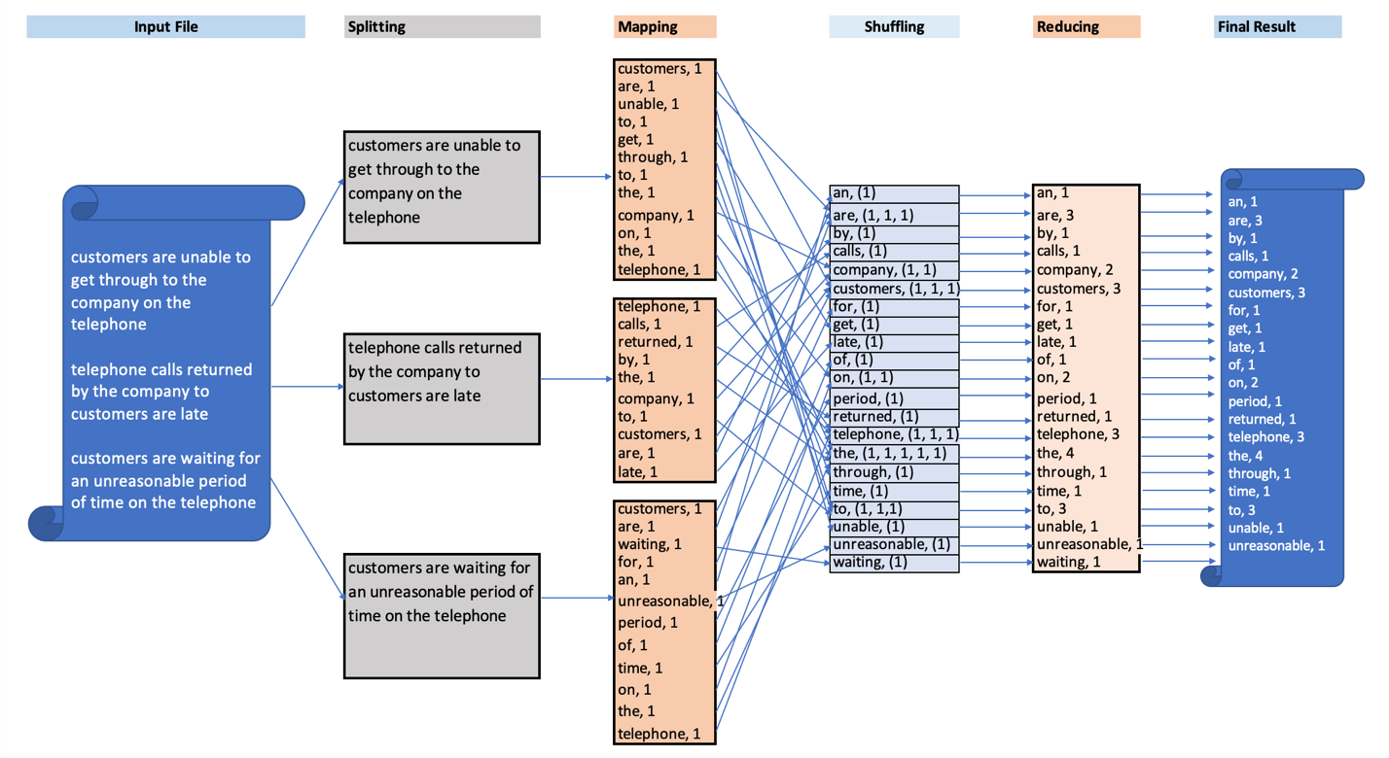
Figure 4-3: Logical Model for the WordCount MapReduce Algorithm

Slide 27
Pseudocode for WordCount: Mapper
Map function uses a tokenizer to read each word in a given line
For each word in the line, the map function emits the word and the number 1
Example:
Intermediate data produced by the mapper are:
(customers, 1), (are, 1), (unable, 1), (to, 1)
function map (k1, v1)
{
tokens [] = tokenize(v1) // tokens = ['customers' 'are' 'unable' 'to']
foreach (word IN tokens){
emit (word, 1)
}
}
Box 4-5: The Pseudocode for the WordCount Mapper

Slide 28
Pseudocode for WordCount: Reducer
Reducer adds all ones for each word
After the mapper processes all words in the input file
Emits the word and the sum
Example:
For k2 = customers and list[v2] = [1, 1, 1]
The output from the reducer => (customers, 3)
function reduce (k2, list<v2>)
{
sum = 0
foreach (v in list[v2]>){
sum = sum + v
}
emit (k2, sum)
}
Box 4-6: The Pseudocode for the WordCount Reducer

Slide 29
Variations of the WordCount Algorithm
Value-to-key conversion:
Provides a scalable solution for secondary sorting
By moving the inverse of the value (sum) into the key:
Exploit the MapReduce execution framework itself for sorting
function reduce (k2, list<v2>)
{
sum = 0
foreach (v in list[v2]>){
sum = sum + v
inverse_sum = 1/sum
k2 = inverse_sum + " " + k2
}
emit (k2, sum)
}
Box 4-7: Adjusting the Reducer to Sort the Output

Slide 30
Variations of the WordCount Algorithm (cont.)
Frequency of a certain set of words—call it a set of keywords:
Mapper emits the (word, 1) pair only if the word is part of the keyword set
function map (k1, v1)
{
keywords [] = ['word1' 'word2' …]
tokens [] = tokenize(v1)
foreach (word IN tokens){
if (word IN keywords) then emit (word, 1)
}
}
Box 4-8: Adjusting the Mapper to Emit from a Set of Keywords

Slide 31
Variations of the WordCount Algorithm (cont.)
Related to categories of words and not specific words
You have two categories and a dictionary of words in each one
Every word is compared to those two dictionaries
The value of a given category is increased when the word is found in that category
The output: the degree of positive and negative emotions
function map (k1, v1)
{
pos_emotions [] = ['happy' 'excitement' 'joy' 'optimistic']
neg_emotions [] = ['sad' 'hurtful' 'pessimistic']
tokens [] = tokenize(v1)
foreach (word IN tokens){
if (word IN pos_emotions) then emit ('PE', 1)
if (word IN neg_emotions) then emit ('NE', 1)
}
}
Box 4-9: The Mapper Code to Generate a List of Categories

Slide 32
The MapReduce in Java
The MapReduce job:
A Java Archived (JAR) file
The JAR file is compiled Java code with other resources and libraries necessary to run the code

Slide 33
Figure 4-4: Java Code for the NYSE MapReduce Algorithm

Slide 34
The MapReduce in Python
Figure 4-5: Python Code for Mapper
Figure 4-6: Python Code for Reducer

Slide 35
Tutorial A: Executing a MapReduce Job with Java
In this tutorial, you will:
Prepare a MapReduce job written in the Java programming language
Execute the job in Hadoop cluster

Slide 36
Tutorial A: Preparing a MapReduce JAR File
Use Eclipse IDE for Java:
Integrated development environment
Software application that provides comprehensive facilities to computer programmers for software development
Found in: https://www.eclipse.org/downloads/

Slide 37
Start a new project by selecting: "File => New => Java project."
Enter NYSE in the "Project name:" textbox and use JavaSE-1.8 from the list of versions available under "Use an execution environment JRE."
This selection ensures that the code shown in Figure 4-4 is executed with Java 1.8.
Click "OK."
Right-click on "src" and select "New => Class" to open the "New Java Class" window.
The source folder should read NYSE/src.
Enter "com.examples" (as suggested in the MapReduce code) in the "Package" textbox.
Also, enter "NYSE_example" as the class name in the "Name" box.
Click "Finish."
Find the file NYSE_Example.java, provided by the instructor or from the textbook’s website and open it with any text editor (Notepad, TextEdit), and copy the code.
Delete everything in the "NYSE_example" window and paste the code from the previous step
Box 4-10: Creating a New Java project

Slide 38
Download the latest version of the hadoop-core JAR file provided in the companion website.
Create a "lib" folder in the "NYSE" project.
Right click "NYSE" then "New => Folder" and choose "lib" as a folder name.
Copy and paste the downloaded hadoop-core JAR from step 1.
Build a path to this JAR:
Right-click on "NYSE" then "Build Path => Configure Build Path…."
Select "Libraries" and then "Add JARs…."
Find folder "lib" and select the hadoop-core JAR.
Click "OK"—Notice that the errors disappear, and the file is ready to be compiled as a MapReduce jar.
Right-click on "NYSE" then "Export… => Jar file => Next."
Browse to a particular destination and name the jar file "NYSE.jar". (This should be the name of the job in your Java code at the driver part of the MapReduce program.)
Box 4-11: Steps for Creating a JAR File

Slide 39
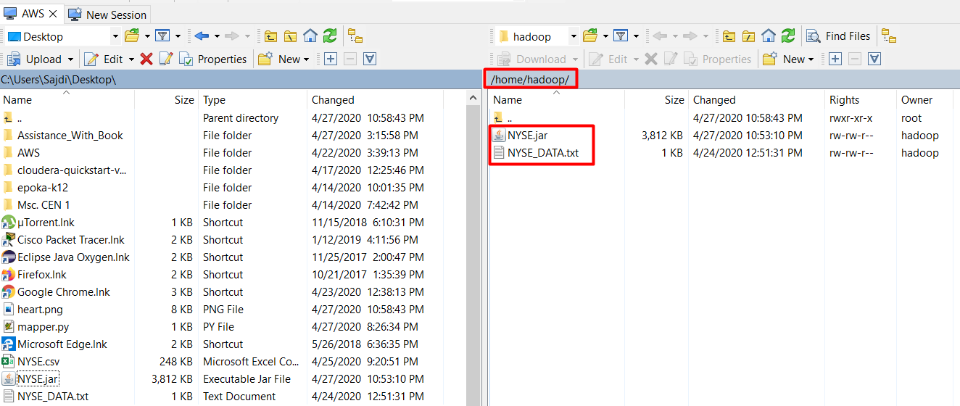
Tutorial A: Executing a MapReduce Job
Connect the cluster to a file transfer program:
Bring the JAR file and the input data from the local computer to the Hadoop home directory
For transferring the necessary files from your computer to the cluster
Figure 4-7: Transferring Files to the Hadoop Home Directory

Slide 40
Tutorial A: Executing a MapReduce Job (cont.)
Create the directories where the files will be placed
Upload the input file to the HDFS system
Run the MapReduce JAR
$ hadoop fs -mkdir MR
$ hadoop fs -mkdir MR/TutorialA
$ hadoop fs -mkdir MR/TutorialA/input
$ hadoop fs -copyFromLocal NYSE_DATA.txt MR/TutorialA/input/input_data.txt
$ hadoop jar NYSE.jar com.examples.NYSE_example MR/TutorialA/input/input_data.txt MR/TutorialA/output

Slide 41
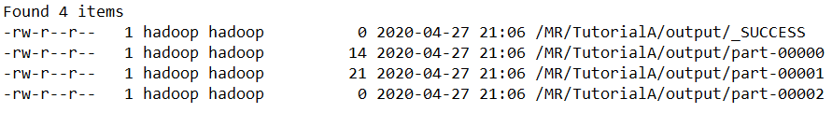
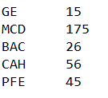
Tutorial A: Executing a MapReduce Job (cont.)
List the output files
Display results
$ hadoop fs -ls MR/TutorialA/output
Figure 4-8: Result Directories Generated by MapReduce with Java
$ hadoop fs -cat /MR/TutorialA/output/p*
Figure 4-9: Results of MapReduce with Java

Slide 42
Tutorial A: Executing a MapReduce Job (cont.)
$ hadoop fs -mkdir MR
$ hadoop fs -mkdir MR/TutorialA
$ hadoop fs -mkdir MR/TutorialA/input
$ hadoop fs -copyFromLocal NYSE_DATA.txt MR/TutorialA/input/input_data.txt
$ hadoop jar NYSE.jar com.examples.NYSE_example MR/TutorialA/input/input_data.txt MR/TutorialA/output
$ hadoop fs -ls MR/TutorialA/output
$ hadoop fs -cat MR/TutorialA/output/p*
Box 4-12: List of Commands to Execute the Java MapReduce Job

Slide 43
Tutorial B: Executing a MapReduce Job with Python
In this tutorial, you will:
Prepare the mapper and reducer written in the Python programming language
Execute the job in Hadoop cluster

Slide 44
Tutorial B: Preparing Mapper and Reducer Python Files
Use a Python integrated development environment (IDE)
Example: PyScripter
Found at https://sourceforge.net/projects/pyscripter/
Start two new Python modules
One for mapper
One for reducer
Paste the respective codes in the respective files for the mapper and reducer

Slide 45
Tutorial B: Executing the MapReduce Job
Create the directories
Transfer the input file to the HDFS system
$ hadoop fs -ls
$ hadoop fs -mkdir MR/TutorialB
$ hadoop fs -mkdir MR/TutorialB/input
$ hadoop fs -copyFromLocal NYSE_DATA.txt MR/TutorialB/input/input.txt

Slide 46
Tutorial B: Executing the MapReduce Job (cont.)
Create the mapper and reducer files with a '.py' extension
Paste the code from the IDE into the files accordingly
Make the files executable by the commands:
$ nano mapper.py
$ nano reducer.py
$ chmod +x mapper.py
$ chmod +x reducer.py

Slide 47
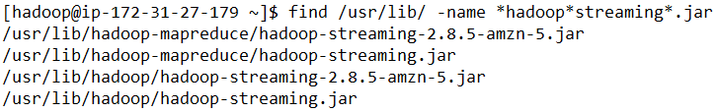
Tutorial B: Executing the MapReduce Job (cont.)
Python:
Reads data from standard input
Writes to standard output
Hadoop Streaming utility:
Comes with Hadoop distribution
Supports Python
Locate the required JAR file using:
$ find /usr/lib/ -name *hadoop*streaming*.jar
Figure 4-10: Hadoop Streaming Location

Slide 48
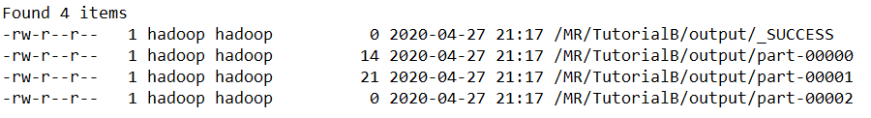
Tutorial B: Executing the MapReduce Job (cont.)
Run the MapReduce job:
Display the deliverables of the program:
$ hadoop jar /usr/lib/hadoop/hadoop-streaming.jar -files mapper.py,reducer.py -mapper mapper.py -reducer reducer.py -input MR/TutorialB/input/input.txt -output MR/TutorialB/output
$ hadoop fs -ls MR/TutorialB/output
Figure 4-11: Result Directories Generated by MapReduce with Python

Slide 49
Tutorial B: Executing the MapReduce Job (cont.)
Display the results of the program:
$ hadoop fs -cat MR/TutorialB/output/p*
Figure 4-12: Results of MapReduce with Python

Slide 50
$ hadoop fs -ls
$ hadoop fs -mkdir MR/TutorialB
$ hadoop fs -mkdir MR/TutorialB/input
$ hadoop fs -copyFromLocal NYSE_DATA.txt MR/TutorialB/input/input.txt
$ nano mapper.py
$ nano reducer.py
$ chmod +x mapper.py
$ chmod +x reducer.py
$ find /usr/lib/ -name *hadoop*streaming*.jar
$ hadoop jar /usr/lib/hadoop/hadoop-streaming.jar -files mapper.py,reducer.py -mapper mapper.py -reducer reducer.py -input MR/TutorialB/input/input.txt -output MR/TutorialB/output
$ hadoop fs -ls /MR/TutorialB/output
$ hadoop fs -cat /MR/TutorialB/output/p*
Box 4-13: List of Commands to Execute the Python MapReduce Job

Slide 51
Summary and Takeaways
MapReduce:
The most fundamental algorithm for processing Big Data in a distributed file system
Called an embarrassingly parallel algorithm
Can be separated into a number of parallel tasks
The patterns covered can be tweaked to perform similar tasks
Example: a slight change in the reducer of the NYSE algorithm can produce other results
The divide and conquer approach:
Allows the processing of a large number of records and text within a short amount of time

Slide 52
Summary and Takeaways (cont.)
The mapper and reducer (and sometimes the combiner) work together through:
Input-output formats (key, value)
Mapper requires:
Input file => (byte_offset, line) structure
Reducer:
Reads the data from the mapper in the (key, value) format
Processes (mostly aggregates) them
Stores the output in a proper (key, value) format
MapReduce:
Powerful technique to perform text-mining analysis
WordCount algorithm (generate the frequency of all words, the frequency of a set of keywords, or sensitivity analysis)
Performs iterative message processing
Product associations (providing recommendations of products that are most likely to be purchased by a customer during their next visit to a store or website)

Slide 53
Summary and Takeaways (cont.)
The NYSE example illustration:
MapReduce in Java code has four major parts:
The import section, the mapper component, the reducer component, and the driver of the program
Execution of MapReduce in the cluster involves two main stages:
Preparing the MapReduce JAR:
Compile the Java code and the Hadoop core into a Java archived file
Executing the MapReduce job
Upload the input file into the cluster
Run the Hadoop jar command to indicate:
JAR name, class hierarchy, directory location of the input file, and directory location of the output

